Slide 1
The right to know
Information Access & Information Literacy

Slide 2
Access: Guarantees and challenges
FOIA
Freedom of the Press
Freedom of Speech
Intellectual Freedom
Manipulation
Propaganda
Fraud
Suppression/Censorship

Slide 3
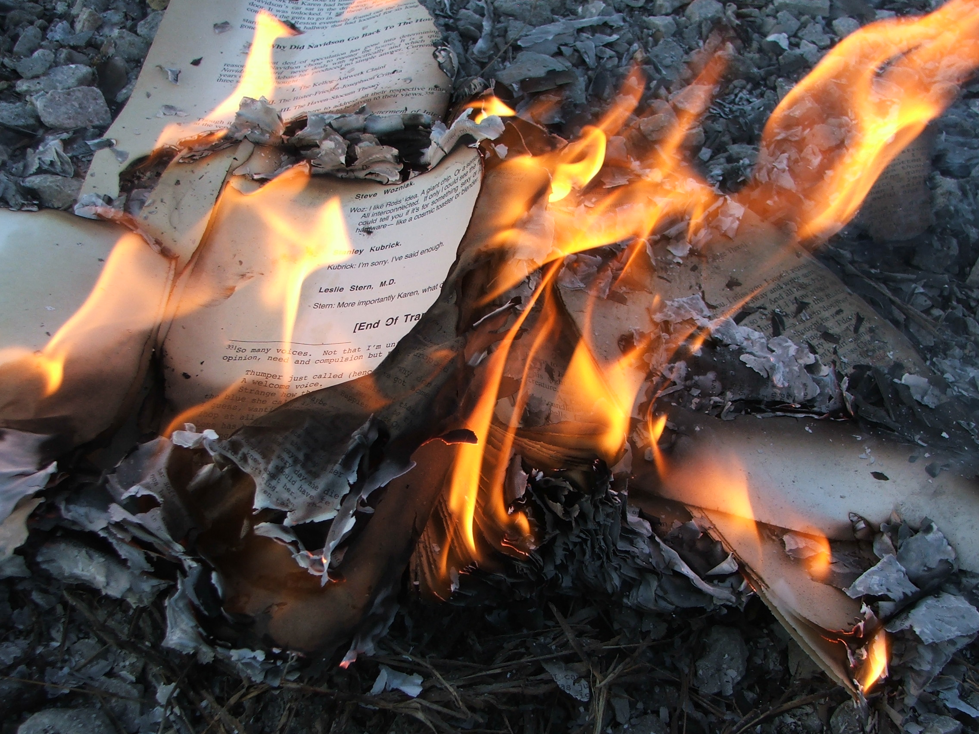
Where they have burned books, they will end in burning human beings
Heinrich Heine, Almansor, 1821

Slide 4
Not all information is accessible… Not all information is good…

Slide 5
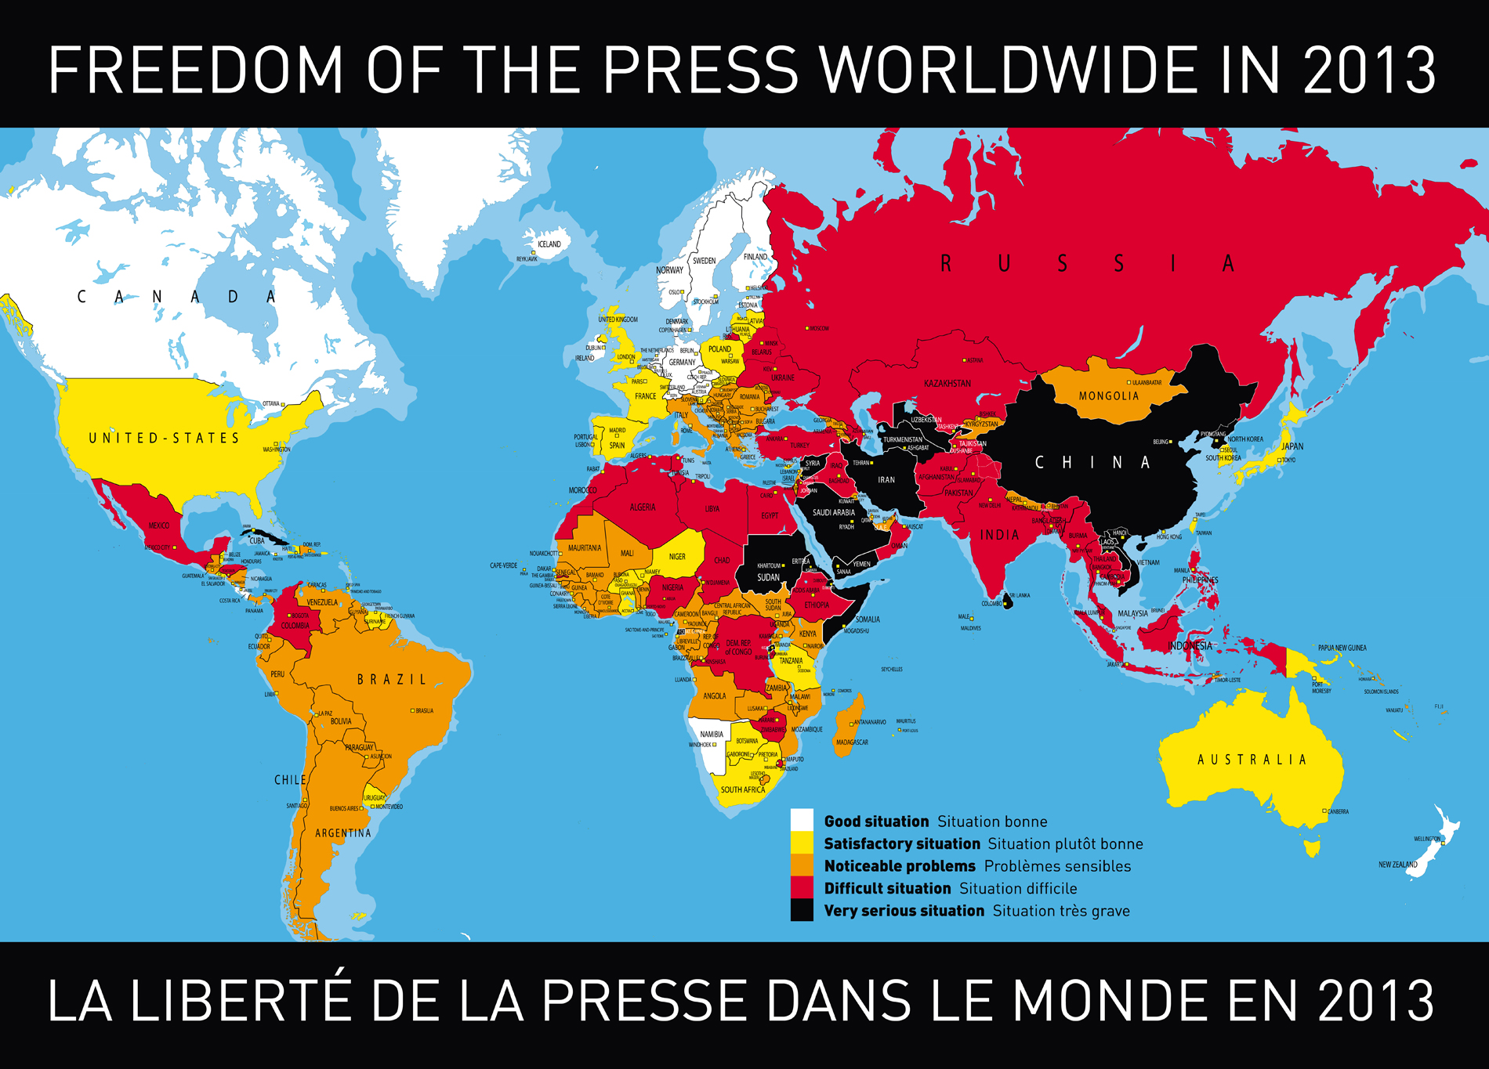
Access should not be assumed
http://en.rsf.org/IMG/jpg/2013_wpfi_world_press_freedom_map.jpg

Slide 6
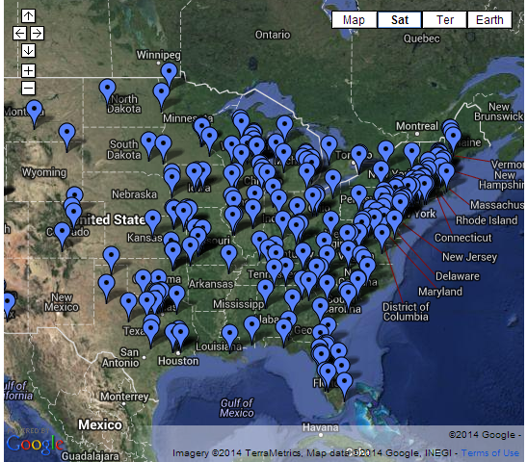
Access should not be assumed
Challenged & Banned Books: http://www.bannedbooksweek.org/mappingcensorship

Slide 7
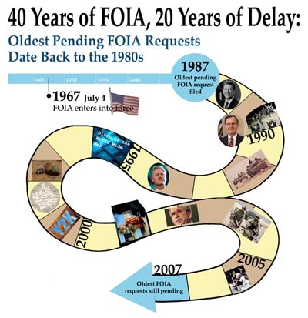
Access should not be assumed
National Security Archive: http://www2.gwu.edu/~nsarchiv/NSAEBB/NSAEBB224/

Slide 8
Even with barriers…
We’re overloaded with Information

Slide 9
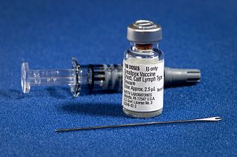
Consequences of misinformation
Uninformed decisions
The continued influence effect

Slide 10
Beyond Access: education
How Do We Make Sense of Information?

