Slide 1
Information Literacy and Accreditation
MCCLPHEI
Laura Saunders June 2016 Simmons College

Slide 2
Standards Emphases
Mission
Planning & Evaluation
Teaching & Learning
Assessment

Slide 3
Highlights of New Standards
Information Literacy in academic programs
Collaboration
Assessment

Slide 4
New Standards
Pros
Cons
Prominent integration of information literacy
Support for collaboration
Implication of librarians as academic staff
Removal of the library standard
Single mention of librarians by name
Reduced emphasis on facilities and collections

Slide 5
Highlights of New Standards
4.12 Expectations for student achievement, independent learning, information literacy, skills in inquiry, and critical judgment are appropriate to the subject matter and degree level and in keeping with generally accepted practice.
4.15 Graduates successfully completing an undergraduate program demonstrate competence in …the skills of information literacy

Slide 6
Highlights of New Standards
4.19 Requirements for the major or area of concentration [include] a mastery of the knowledge, information resources, methods, and theories …in-depth understanding of an area of knowledge or practice, its principal information resources.
4.25 Graduate programs emphasize the acquisition, organization, utilization, generation, and dissemination of knowledge…the subject matter, theory, literature, and methodology of a significant field of study.

Slide 7
Highlights of New Standards
4.46 Faculty and students receive sufficient support for instructional and other needs. Students have ready access to and support in using appropriate learning resources. T

Slide 8
Highlights of New Standards
6 The institution supports teaching and learning through a well-qualified faculty and academic staff, who…collectively ensure the quality of instruction and support for student learning.
6.2 There are an adequate number of faculty and academic staff, including librarians… Responsibilities include instruction, accessibility to students, and the systematic understanding of effective teaching/learning processes and outcomes in courses and programs for which they share responsibility.
6.14 The institution periodically evaluates the sufficiency of and support for academic staff and their effectiveness in teaching and advising, scholarship, service

Slide 9
Highlights of New Standards
7.21 The institution has sufficient and appropriate information, physical, and technological resources necessary for the achievement of its purposes wherever and however its academic programs are offered. It devotes sufficient resources to maintain and enhance its information, physical, and technological resources
7.22 The institution provides access to library and information resources, services, facilities, and qualified staff sufficient to support its teaching and learning environments and its research and public service mission as appropriate.

Slide 10
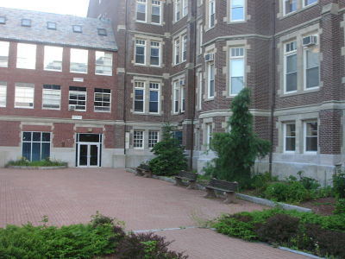
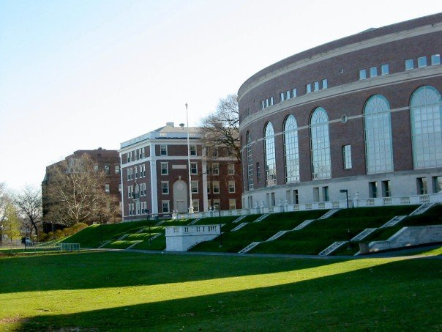
Mass Bay Community College & Wesleyan University
How are library and library-related areas presented?
Where is the emphasis?
Where are there opportunities for growth?
What can we learn?
How could these studies be adapted to the new standards?
http://theswellesleyreport.com/wp-content/uploads/2010/07/2010wellsmassbayrte16bridge-017_opt.jpg
https://en.wikipedia.org/wiki/Wesleyan_University#/media/File:Wesolin.jpg
Notes:
MBCC
Emphasis on workforce skills and transferability
IL important for these
New programs– cybersecurity, health sciences, etc. could include specific areas of IL
Admissions & Curriculum Committee– evaluates curriculum, approves new programs, establishes competencies, etc- library presence?
Mention of library and resources– instruction for students and faculty, embedding
Gen ed includes technological/ computer/information science facility and critical thinking
Mentions support of staff in achieving outcomes
Required courses in Computers and Tech, Critical Thinking– library/IL integration?
Various assessments– research papers, capstones, portfolios– library/IL integration?
Library standard– inputs and outputs of collection (still impt according to Ithaka and strategic plans)
Solid emphasis on IL instruction for faculty and students, attention to ACRL Framework, and assessment– how could this be addressed and integrated into self-study for new standards?
Wesleyan
Mentions staff as part of undergraduate curriculum review
Mentions “historically deep investment in library resources” in undergrad section on teaching and learning
Includes “information literacy” as an essential capability for undergrads– courses are designated that focus on these, and students self-assess through portfolios…but questions about usefulness of this approach
Integration of “research” outcome in FYI course--Students in first-year seminars will become familiar with the methods used to collect, interpret, analyze, and present evidence as part of a scholarly argument.

Slide 11
Approaching the Self-Study
Library mission
Strategic plans and goals
Organizational and strategic position
Areas of emphasis?
Teaching
Collections
Areas for growth

Slide 12
Effective Self-Study
https://pixabay.com/en/photos/studying/
Notes:
Focus on language of standards
Get librarian presence on chapter teams
Different focus between administrators and faculty
Focus on assessment
Visiting teams drive change

Slide 13
Beyond the Self-Study
https://pixabay.com/en/the-strategy-win-champion-1080536/
Notes:
Strategic planning
Alignment
Environmental scanning
Get involved in governance and assessment
Identify relevant goals in self-study and strategic plan
PIL
Ithaka

