Slide 1
The Intentional Instructor
Laura Saunders
Boston Public Library
January 28, 2014

Slide 2
Today’s Topics
Overview
Planning for Instruction
Teaching Methods: Beyond the Lecture
Extras: Designing Slides & Handouts
Open Discussion
Image from http://pixabay.com/en/blonde-teacher-woman-female-school-160653/

Slide 3
Objectives
By the end of today’s session, we will be able to
Critique and create a basic lesson plan
Identify and apply several active learning techniques
Create effective learning materials

Slide 4
But What just happened?
Image from http://www.flickr.com/photos/-bast-/349497988/

Slide 5
Planning for Instruction
Image from http://www.flickr.com/photos/76074333@N00/317952268/

Slide 6
What Makes a Good Lesson Plan?

Slide 7
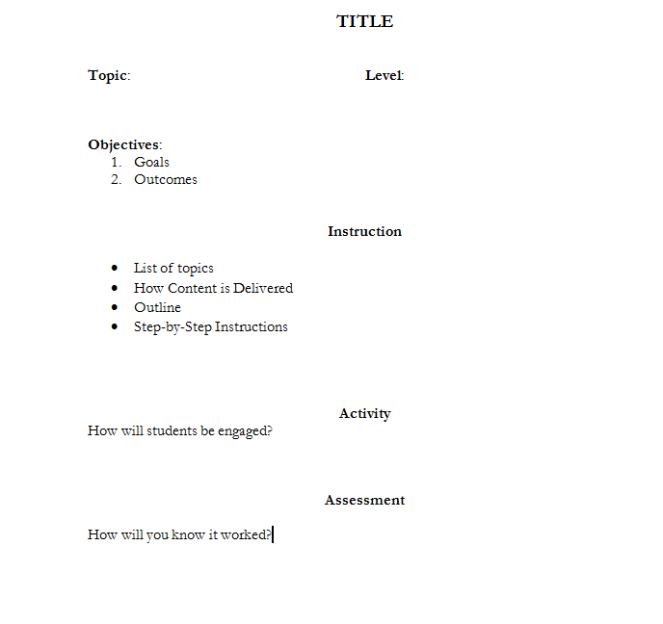
Anatomy of a lesson plan

Slide 8
Teaching Methods: Beyond the Lecture
Image from http://www.fotosearch.com/clip-art/lecture.html

Slide 9
Active learning
Discussions
Games
Hands-on practice
Socratic/Cephalonian
Experimentation
Problem-based learning
Why use active learning?

Slide 10
Active learning
What techniques are you familiar with?
Which have you tried?
What has worked, and what hasn’t?

Slide 11
Active Learning
Is it always right?
Image from http://school.discoveryeducation.com/clipart/clip/hands2-color.html

Slide 12
Learning Materials
Image from http://www.flickr.com/photos/peter_roberts/4457615801/

Slide 13
Design for Success
Avoid jargon
Balance text and graphics
Use pictures and words
Use arrows, boxes, etc to guide the viewer
Consider translation tools

Slide 14
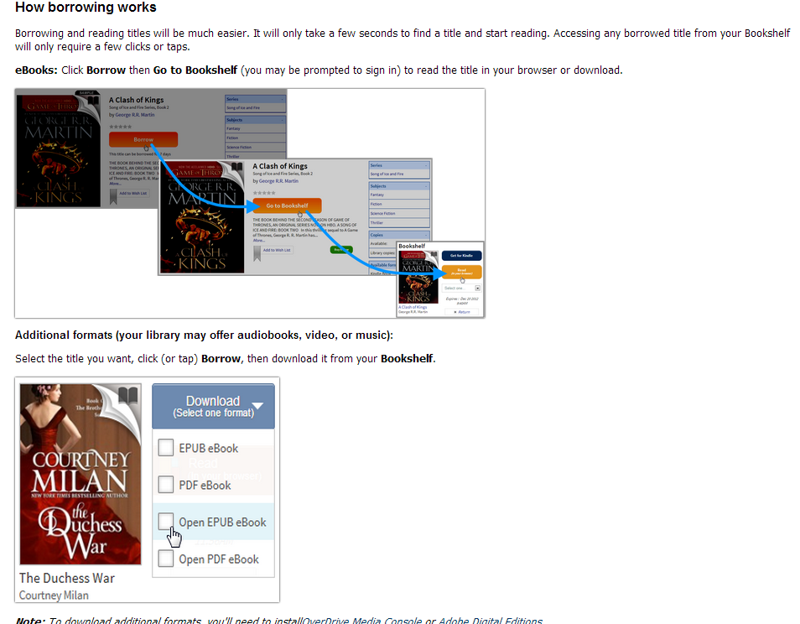
Design for Success

Slide 15
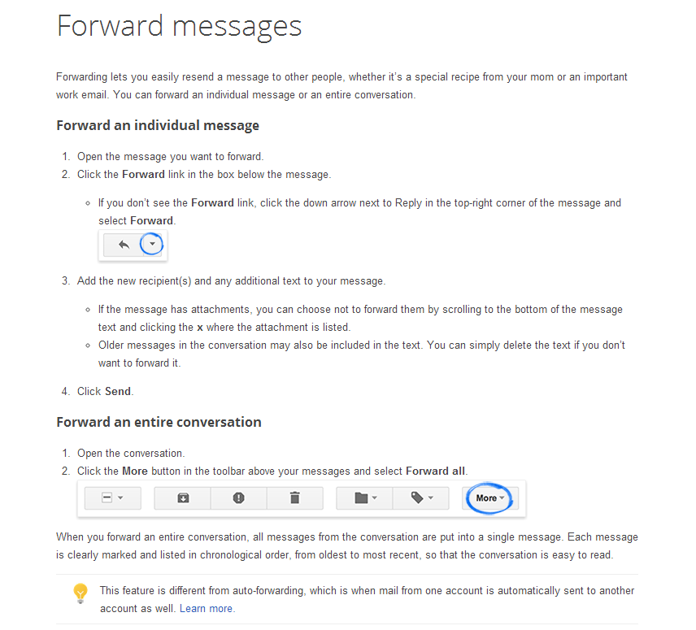
Design For success

Slide 16
Just remember…
With instruction…

Slide 17
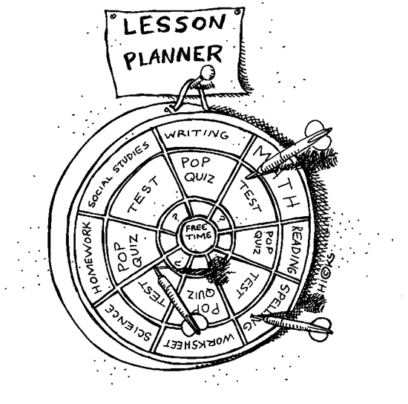
It’s all about intent
Image from http://school.discoveryeducation.com/clipart/clip/dartboard.html

