Slide 1
Books & Beyond: Trends in the Future of Libraries
Laura Saunders
@bibliolaura laura.saunders@simmons.edu

Slide 2
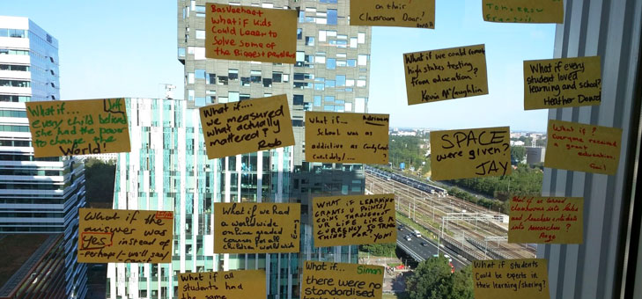
What if….?

Slide 3
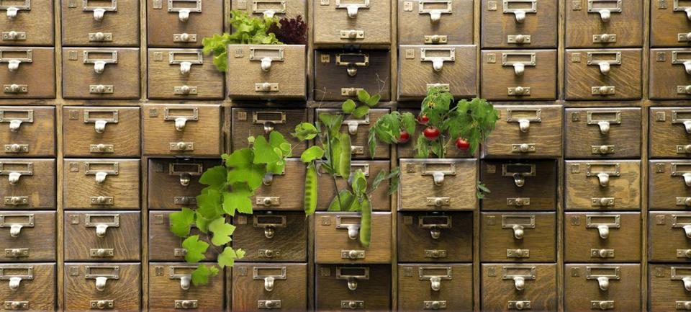
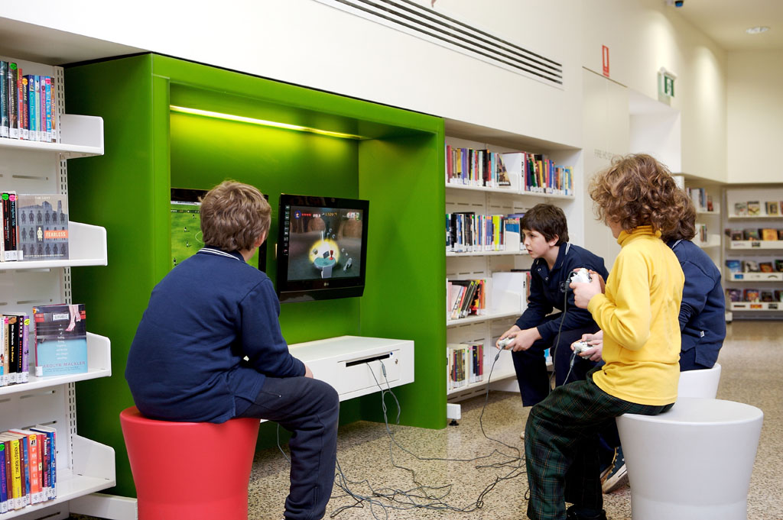
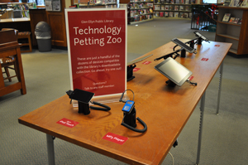
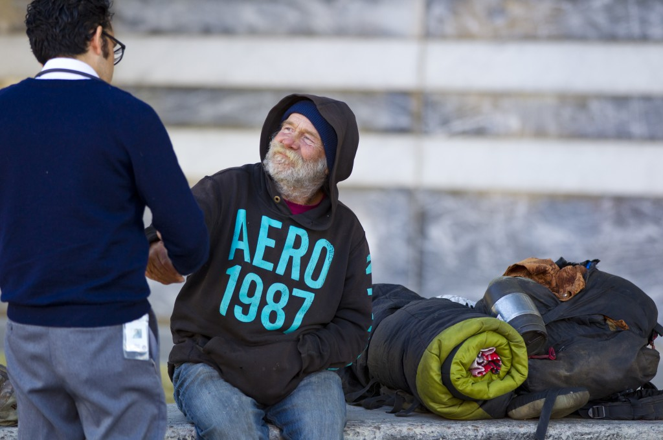
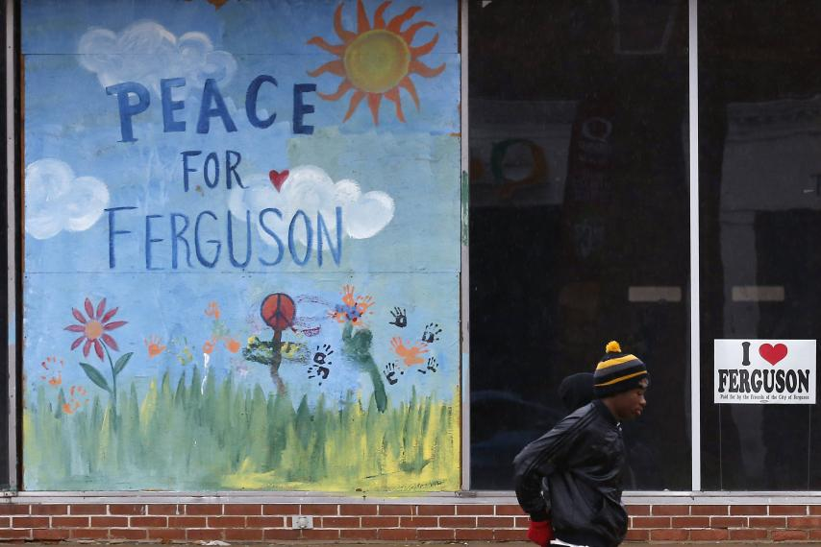
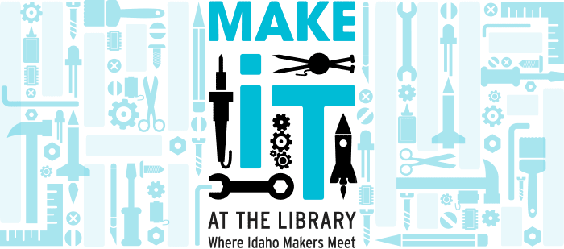
A Few Cool Examples…
Non-traditional Collections
http://orangehomegrown.org/community/seed-lending-library/
Gaming
http://www.libraries.sa.gov.au/page.aspx?u=58
Tech Petting Zoo
http://gepl.org/2011/11/library-offers-technology-petting-zoo-laptop-checkout/
Libraries Add Social Workers, Social Services
http://www.pbs.org/newshour/rundown/see-libraries-across-country-serving-homeless/
Makerspaces
http://libraries.idaho.gov/page/make-it-library-where-idaho-makers-meet
http://www.newsweek.com/ferguson-library-open-286946

Slide 4
A Future Built Firmly on the Past
Mission
Education
Entertainment
Community
Public Discourse
Sharing
https://pixabay.com/en/medieval-castle-detail-84336/

Slide 5
Impact of Libraries
Economic
Social
Educational

Slide 6
Measuring impact
ALA value calculator
How Libraries Stack Up
US Perspectives

Slide 7
References
See, e.g., http://www.ala.org/research/librariesmatter/taxonomy/term/131
http://www.freelibrary.org/about/Fels_Report.pdf
http://www.libsci.sc.edu/metaweb/ValuingPublicLibraries_FinalReport.pdf
http://www.ibrc.indiana.edu/studies/EconomicImpactOfLibraries_2007.pdf
Debono, B. (2002). Assessing the social impact of public libraries: what the literature is saying. Australasian Public Libraries And Information Services, (2), 80.

Slide 8
A Few Lessons Learned…
Planning
Community input
Advocacy

Slide 9
What Would Your Library Look like?

